Slide 1


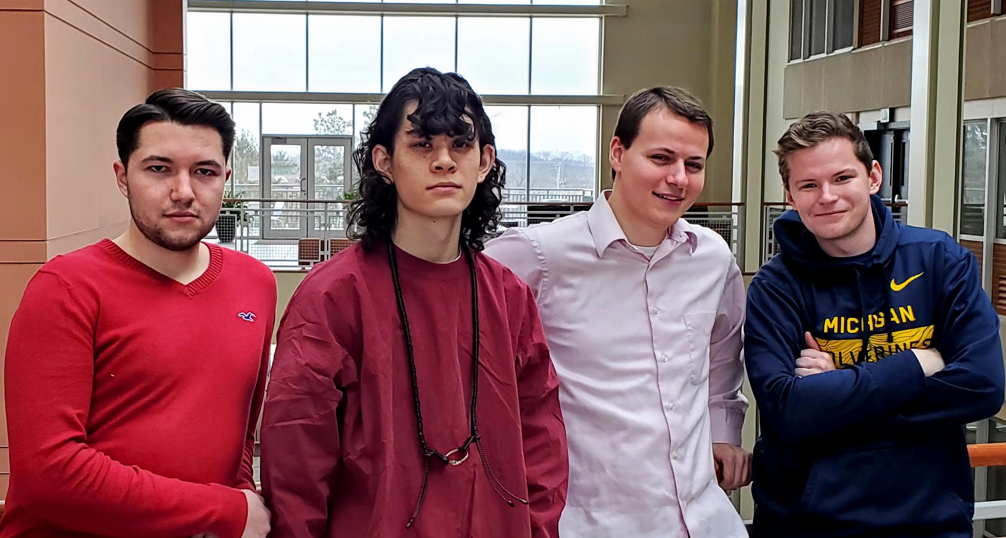
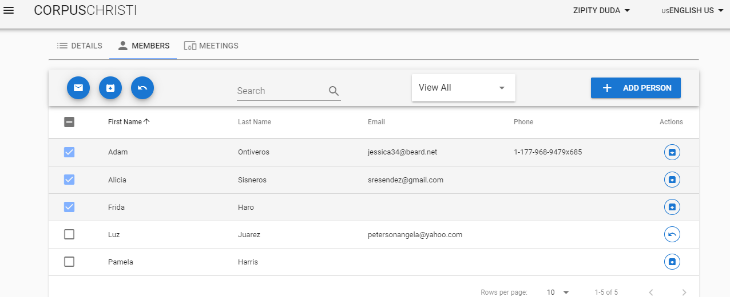
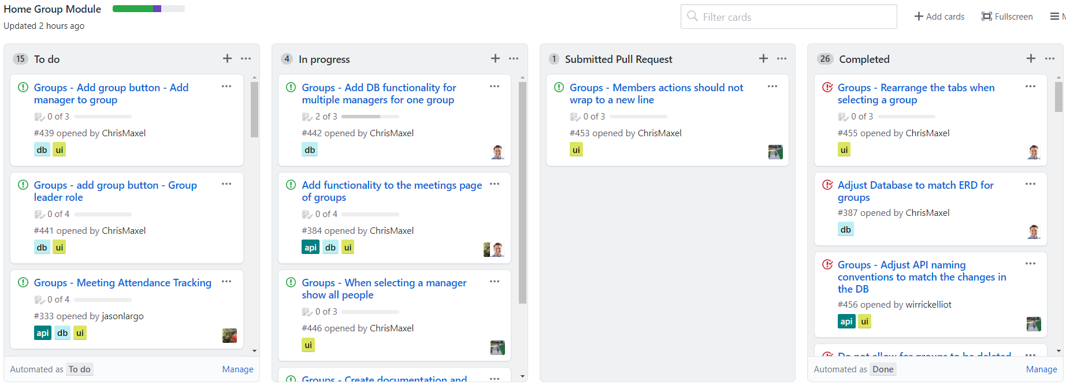


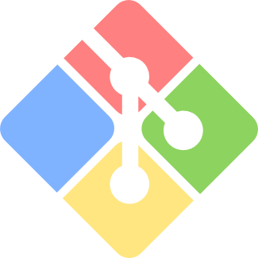


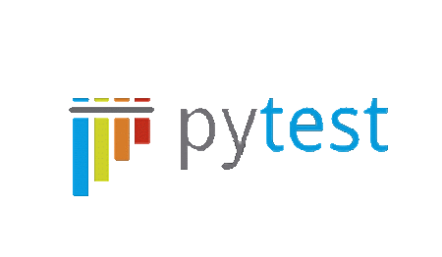



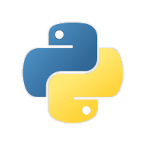
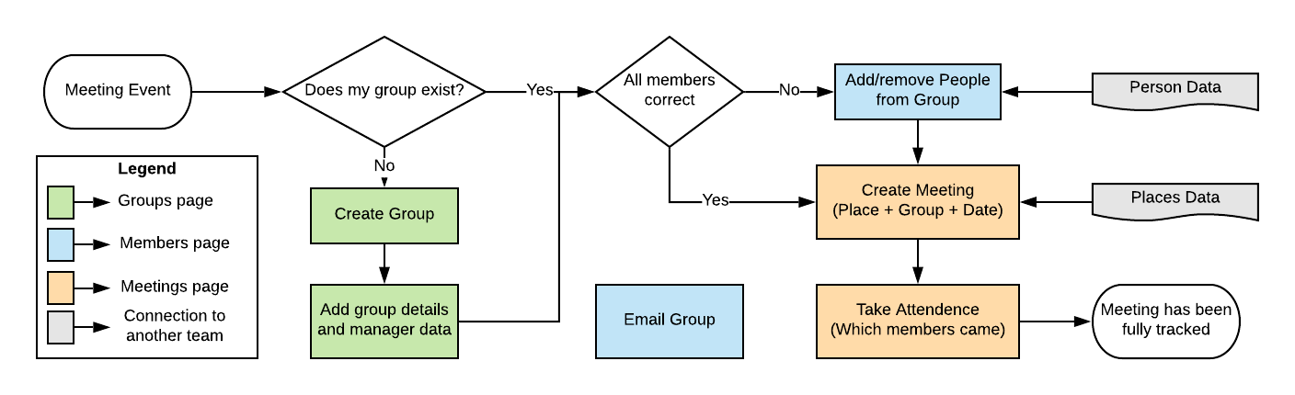
Arco Church: Corpus Christi Homegroups
Christopher Maxel, Elliot Wirrick, Jordan Wood, Matt Dean, Tom Nurkkala
Arco Church
Arco is a Christian church with a goal for us all to grow together in Jesus Christ. In January of 2019, a group of computer science students traveled to Cuenca, Ecuador to build an advanced class management and tracking system for Arco. Our contact there, The Guido Brothers, wanted the project to keep track of attendance. Previously, the church had been doing attendance tracking with Excel, causing inaccurate records.
Why Arco Church?
Dr. Nurkkala has built many key relationships across the globe to help connect his students to customers in need of software. Dr. Nurkkala met the Guido brothers as they shared about this need at Arco. The church was struggling to keep track of its congregation and its attendance was stagnant despite pulling about 50 new visitors per week.
Start:
Recognized the vision - to build Arco Church a class management system.
Set up our local development environments.
Learned a new code base.
Got familiar with the Home Groups module and analyzed its gaps in functionality with regard to Arco’s requirements.
The appointed team lead (Chris Maxel) created manageable, bite-sized user stories to help developers learn the code base and add important functionality.
Designed our agile process for accomplishing tasks.
Process:
The designated developers (Elliot Wirrick, Matt Dean, and Jordan Wood) selected a story that was towards the top of the priority list and piqued their interest.
Developers completed the selected work and committed their changes to a new branch.
Manual testing was done to ensure good code.
After the story was finished, a pull request into the project’s development branch was created for Dr. Nurkkala to approve.
Once approved, the code changes were merged.
The changes were then live and an active part of the test system.
The story was then closed and move it to the “Completed” column of our Kanban board.
Results:
31 User stories completed as a team.
A more dependable and elegant database structure.
Groups can now have meetings with attendance tracking.
A Group can now represent more than just a Home Group, but rather any kind of group (church board, youth group, etc.), according to a church’s unique needs.
Experience working on a full stack development project for an international customer.
Acknowledgements
Our team would like to thank Dr. Nurkkala for building a selfless relationship with The Guido Brothers in Ecuador to allow for us to benefit from sharing the knowledge we’ve learned during our time at Taylor with an incredible church.
We would like to also thank all of our Taylor professors for not only teaching us academically throughout the years but also imparting their wisdom and being there for us in times of need.
Conclusion
Through this project, we had the opportunity to learn a variety of technical tools, what it's like to inherit a pre-constructed code base, and about working on an agile scrum team where we were in constant communication. Our primary takeaway from the project was gaining a new perspective on the workforce we will soon enter.
Contact us: chris_maxel@taylor.edu, mdean400@gmail.com, wirrickelliot@gmail.com, jordaniwood@gmail.com

